Slide 1
Mangrove Canopy Height Estimation
Dillon Hicks, Mark Liu, Kathy Qi, Jeremy Smith

Slide 2
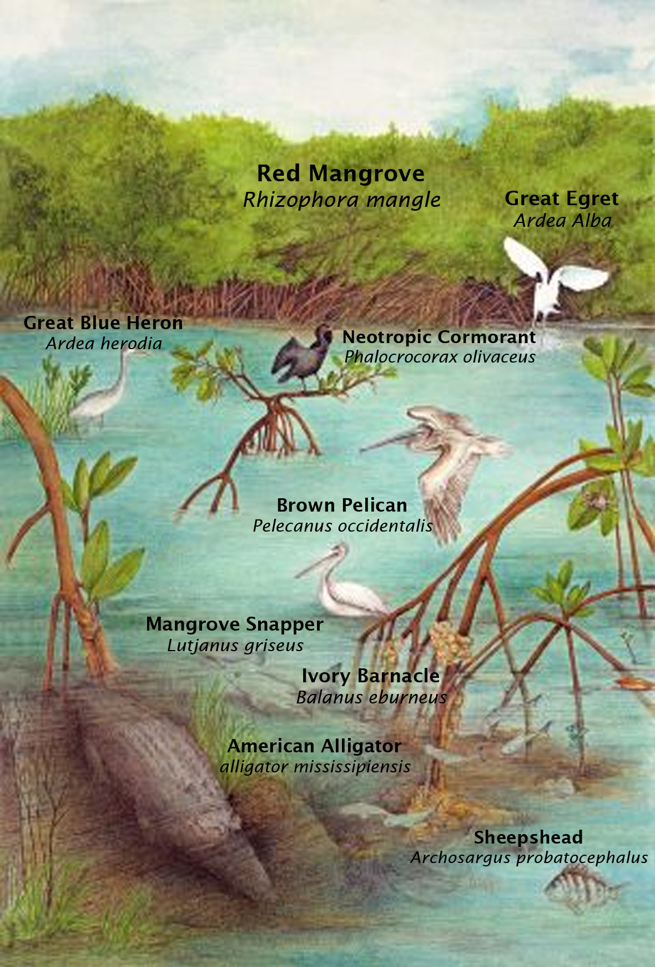
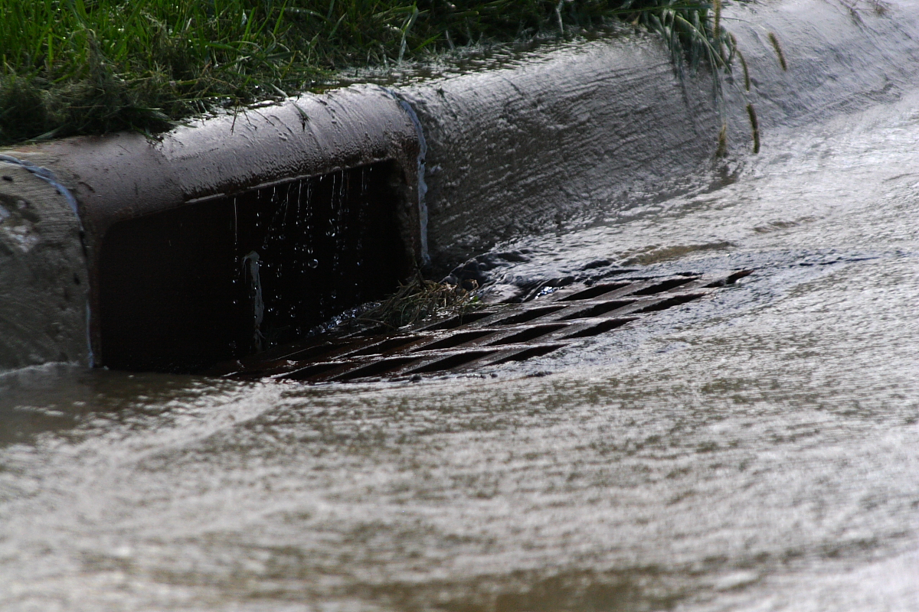
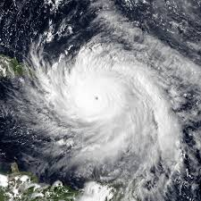
Why do we care about mangroves?
Wave energy dissipation
Pollutant filtration
Delicate ecosystem
Notes:
It is incredibly important to keep mangrove forests around the world healthy. Mangrove forests grow dense root systems that heavily contribute to dissipating wave energy, such as those of hurricanes or tsunamis. The roots additionally help to filter out pollutants from the water, while the mangrove itself sequesters carbon from the atmosphere. Finally, the forest helps support the ecosystem around it, providing shelter for both wild animals and fisheries.

Slide 3
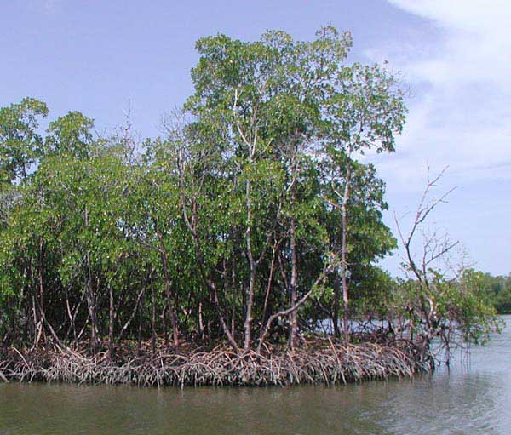
Height Estimation
Difficult to accurately measure height
Two approaches: bottom-up and top-down
Notes:
In order to assist with measuring biomass, the second part of our project addresses the problem of estimating the mangrove canopy height. Due to the uncontrolled environment, it can be difficult to deploy measurement tools or to gather accurate data. We are currently considering two different potential approaches: Using a pole-like measuring tool from the mangrove forest floor, and deploying a measuring device from above the canopy via a drone.

Slide 4

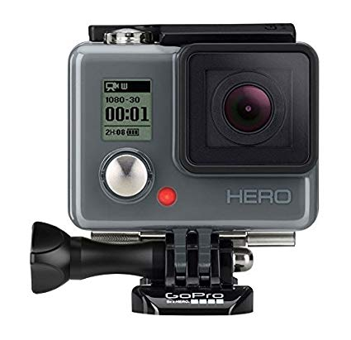
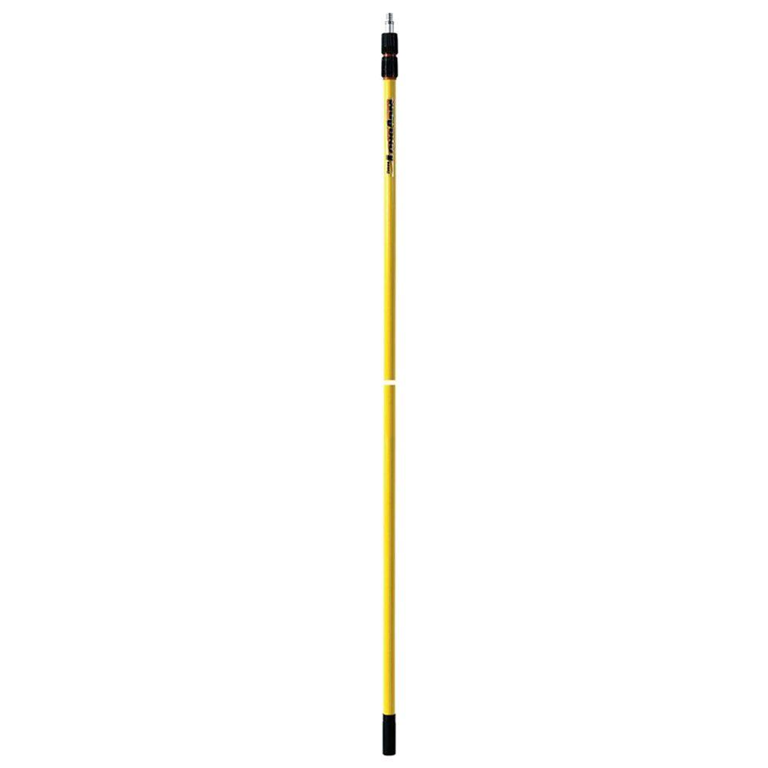
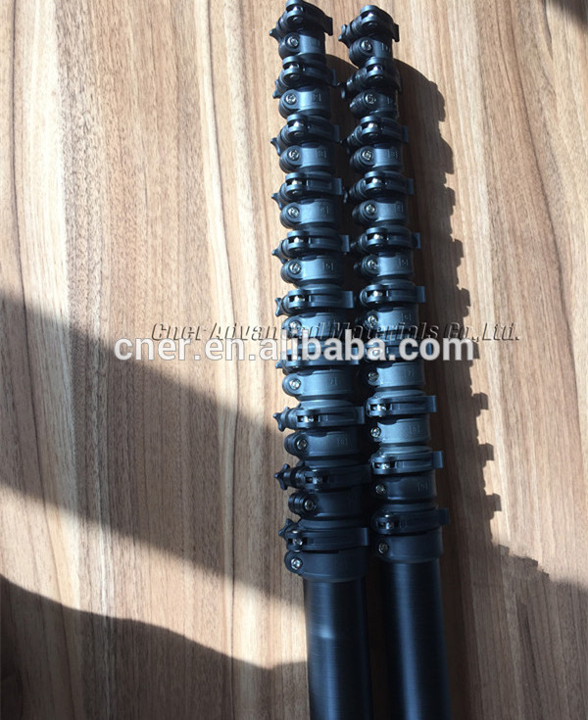
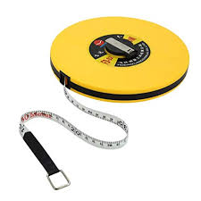

Bottom-Up
Telescopic pole
Camera with housing and tablet
Measuring tape inside pole
Extend to canopy then take measurement
Notes:
Notes:

Slide 5
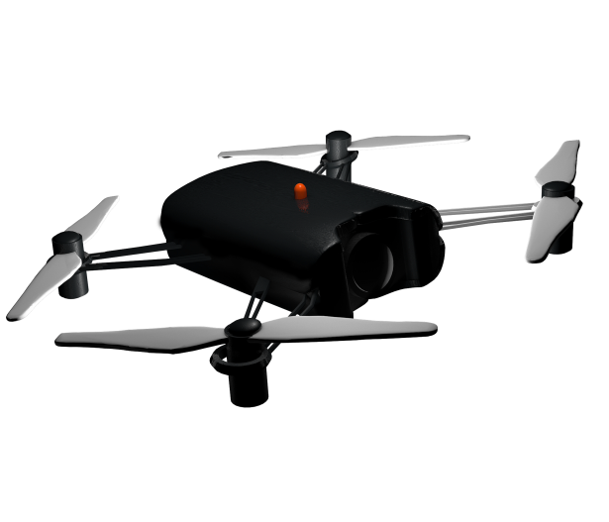
Top-Down
Idea: We use devices (such as sensors and drones) to measure the canopy height from above
Possible strategies
Suggestion by Eric:
Have the drove hover above the mangroves and drop an sensor-equipped object with a string attached to the drone
Need to decide the shape and material of the object encasing the sensor
Drone with a string long enough to reach the bottom
Sensors
LiDAR - Expensive
Ultrasonic(?)
Equip the drone with a transmitter and align the transmitter with the receiver on the bottom. The distance would be the height of the canopy

Slide 6
Questions?

